Slide 1
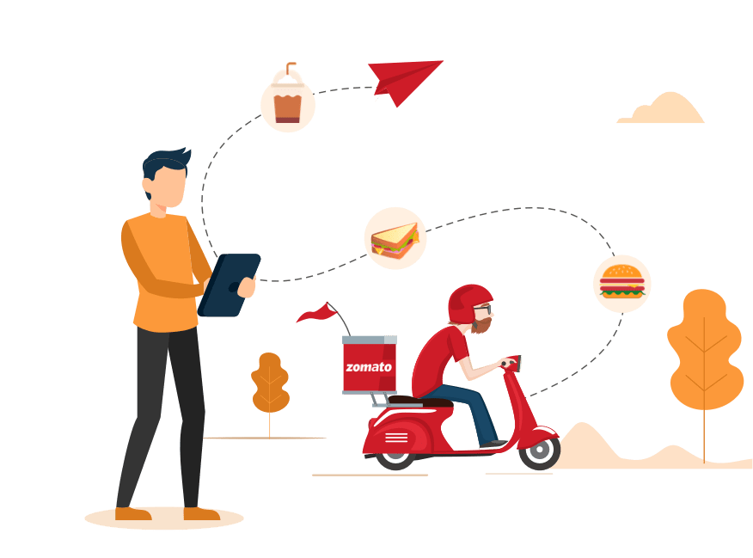
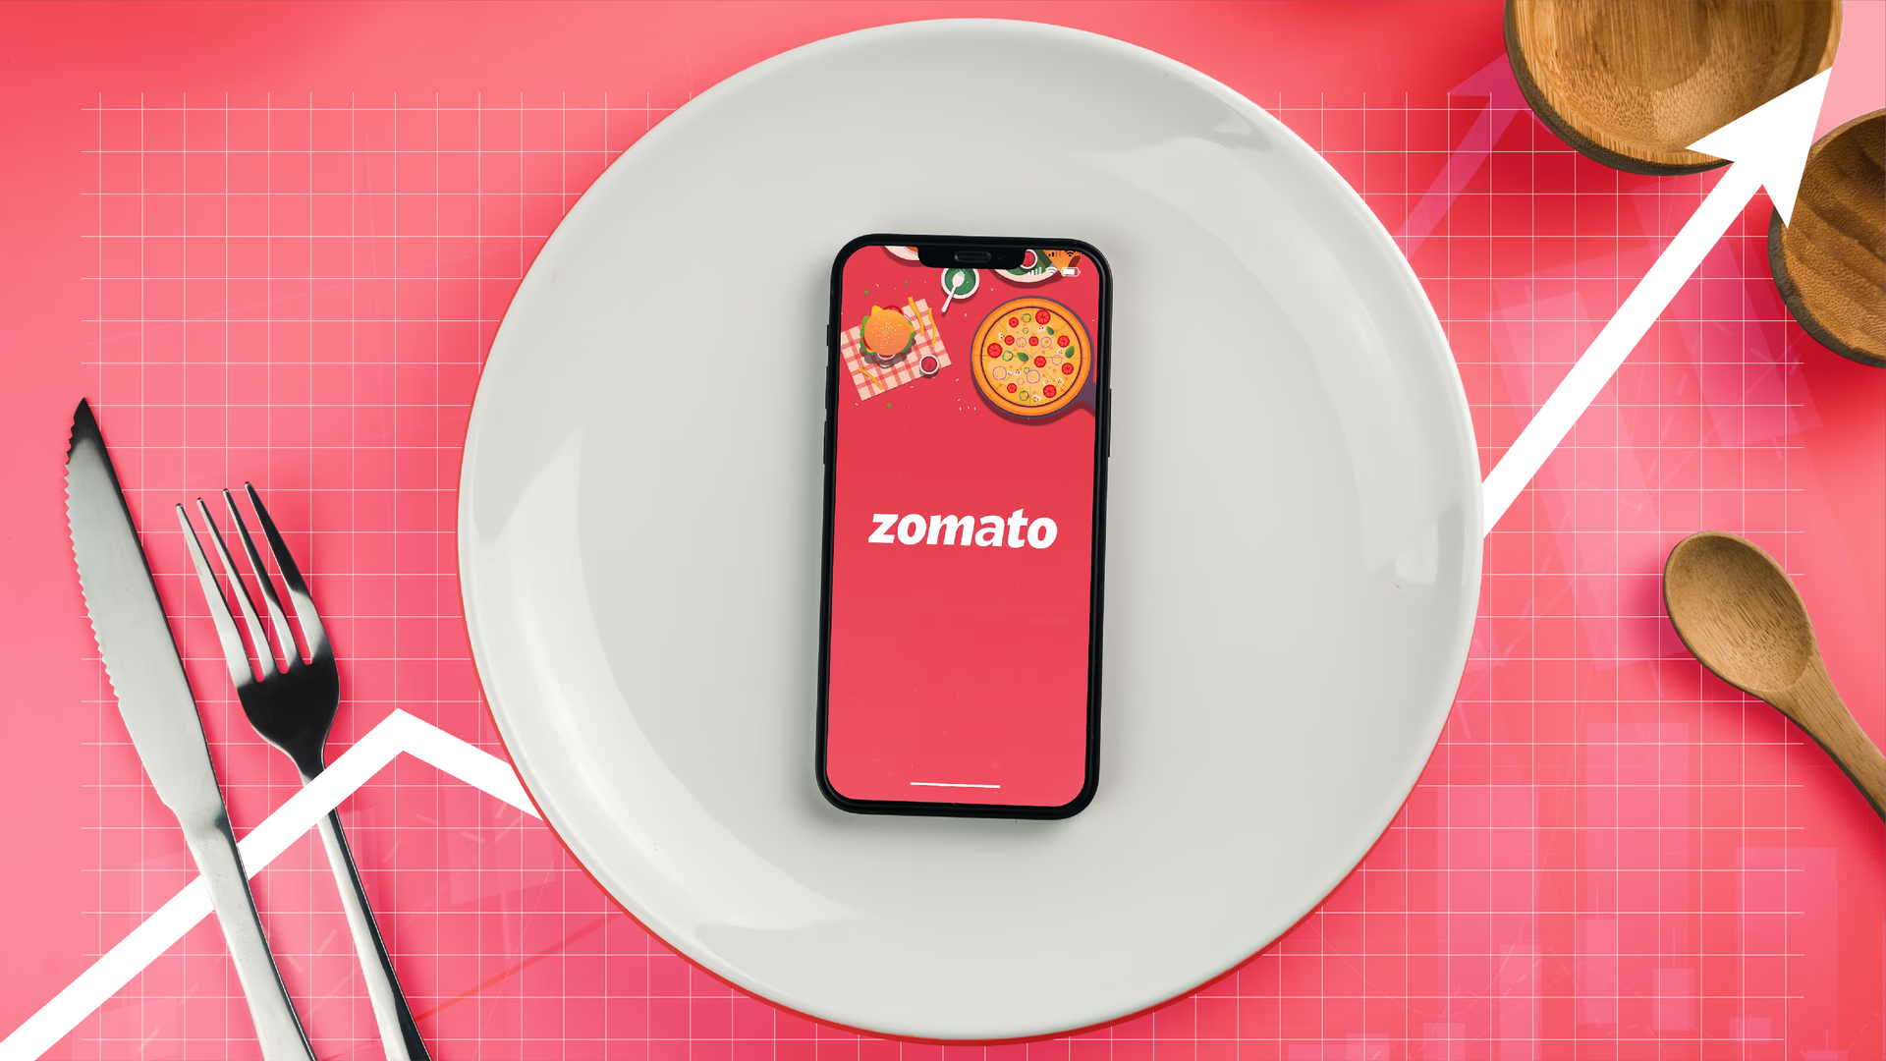
Zomato Dashboard Analysis
Mentor: Rajashekhar Madishetty
Co-Mentor: B. Harish
Team members: Shraddha, Saras, Prity, Omkar, Shrutika, Avantika, Atharva

Slide 2
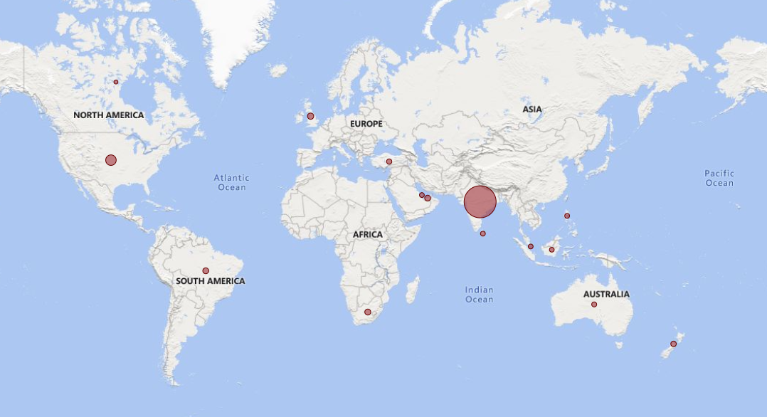
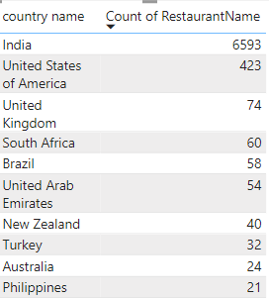
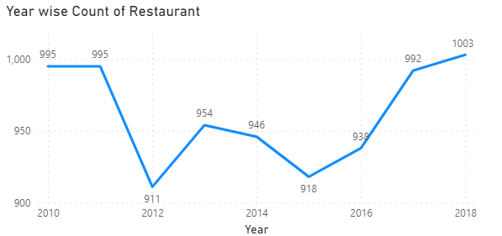
KPI – Country wise restaurant count
India is harbouring majority restaurant count (6593 nos.), followed by USA (423 nos.)
Although there was a sharp decline in restaurant count in 2012 & 2015, there is a significant growth in the no. of restaurants observed from 2015 onwards ( 10% increase observed)
Possibility of majority of restaurants not connected with Zomato.

Slide 3
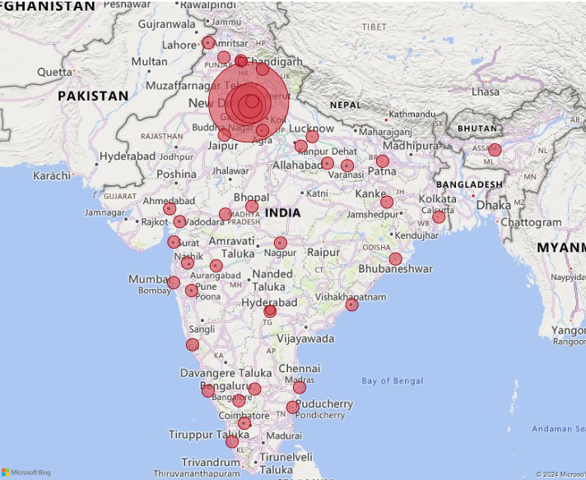
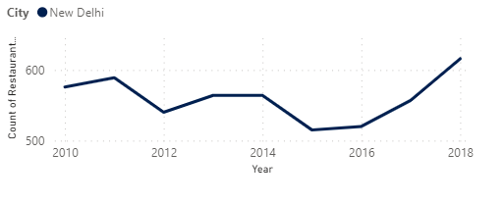
KPI – City wise restaurant count
New Delhi is the city with highest no of restaurants, more than 85% of the retaurants in India are in New Delhi
Other locations have only 20-25 nos of restaurants.
New Delhi being the capital has the majority nos. Need to expand business in major metropolitan cities –Mumbai, Bangalore, Pune, Chennai, Ahmedabad, Hyderabad, Kolkata.
Also increasing trend in restaurant count from 2015 onwards (similar to overall trend w.r.t country wise restaurant nos.)

Slide 4
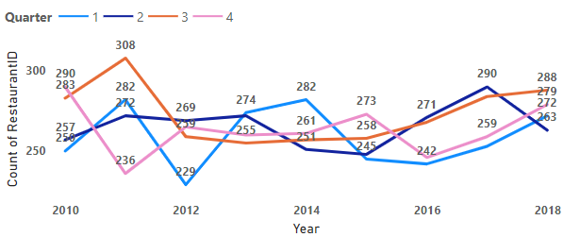
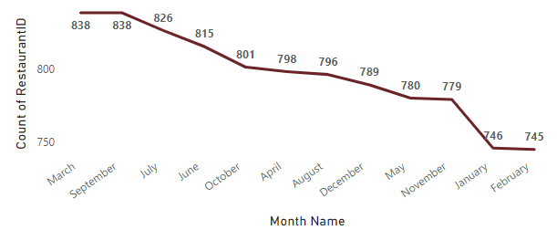
KPI – Restaurant count w.r.t Year/Month/Qtr
Yearly significant growth observed in no. of restaurants from 2015 onwards
Quarterly trends also increasing for QTR 1,3 & 4 ( slight decline of QTR 2 from 2017 to 2018 – 10% decrease)
Taking a look on the months (sum of restaurants month wise) – majority restaurants opened up/registered with Zomato around March/September/July/October – possibly on account of vacations or festival months

Slide 5
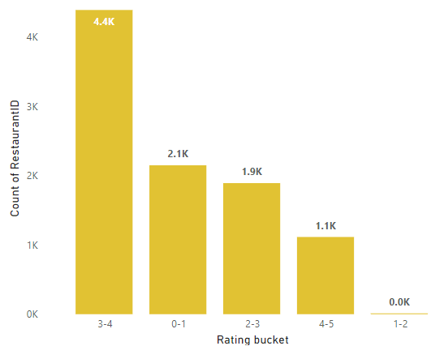
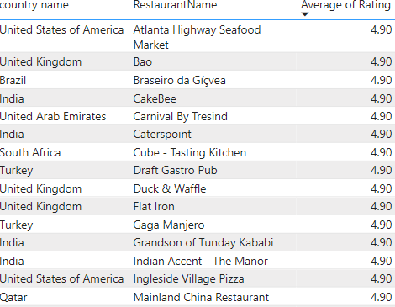
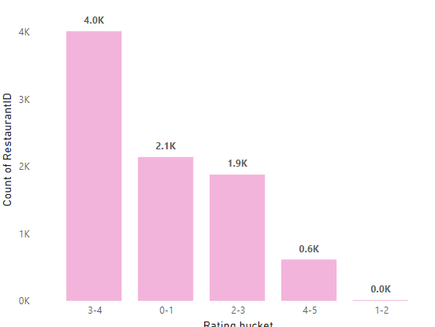
KPI – Ratings for restaurants
Top 15 retaurants with avg rating = 4.9
4 reaturants from India, 3 from UK , 2 from US make in the list
Almost 5.5K restaurants from the world are have avg ratings >3
Only 10% of the restaurants in the world are in top ratings (4-5)
60% of Indian restaurants have rating
3-4, 30% with 0-1 rating & only ~5% with rating>4
Top 15
Ratings for Indian Rest.

Slide 6
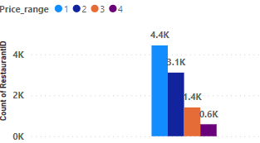

KPI – Restaurants based on price range
World
46% of the restaurants are in the Price range = 1
Only 6% of the restaurants in the price range = 4
India
65% of the restaurants are in the Price range = 1
Only 5% of the restaurants in the price range = 4

Slide 7
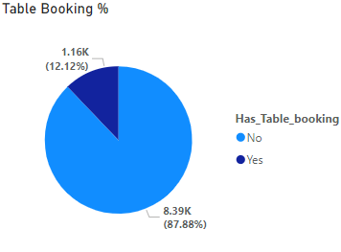
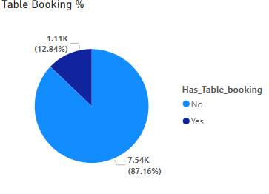
KPI – Restaurants on Table bookings
World
Only 12% of the restaurants have table booking facility
India
Only 13% of the restaurants have table booking facility

Slide 8
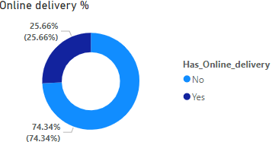
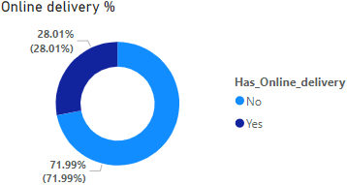
KPI – Restaurants on Table bookings
World
Only 26% of the restaurants have online delivery facility
India
Only 28% of the restaurants have online delivery facility

Slide 9
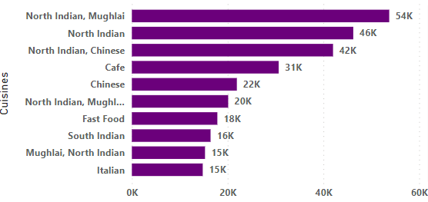
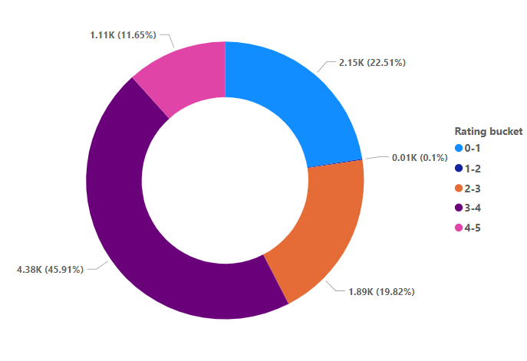
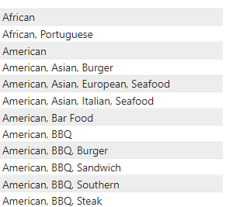
KPI – Cuisine based analysis
Top 10 shows majority of Indian cuisines (North Indian Dishes) have received maximum votes (20%)
Italian & Chinese cuisine also made its way in the top 10 cuisines
Top 10
55% of the cuisines have >5 rating
Top Quality cusines include the African & American BBQ dishes

Slide 10


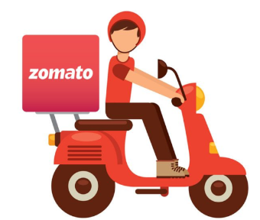
Overcome Challenges
Geography
Technology
Service-based
Expansion in Asian & American countries
For Indian market, expansion in metropolitan cities
Including multivariety cuisine w.r.t geographical preferences
AI-based online delivery tracking
Focusing on low rating cusines/restaurants.
Increasing in online table booking facility
Packaging innovations – using eco-friendly packaging, anti-leakage packaging
Increase in delivery agents
Reduce downtime in food deliveries

Slide 11
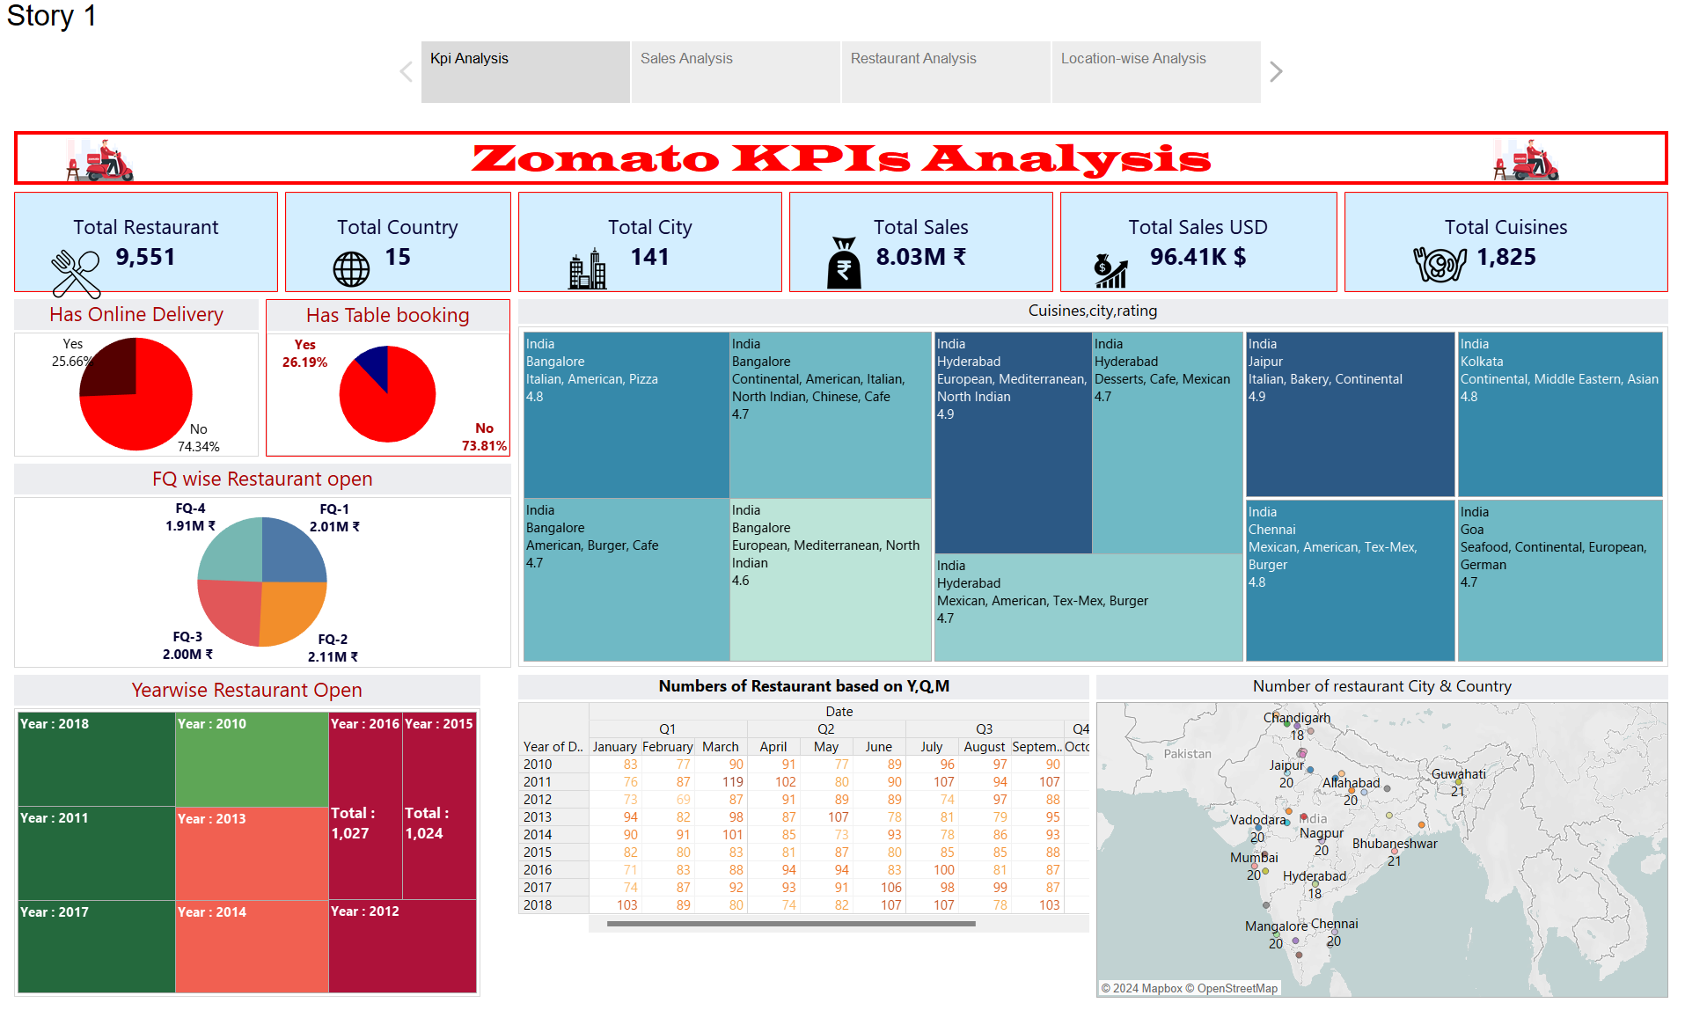

Slide 12
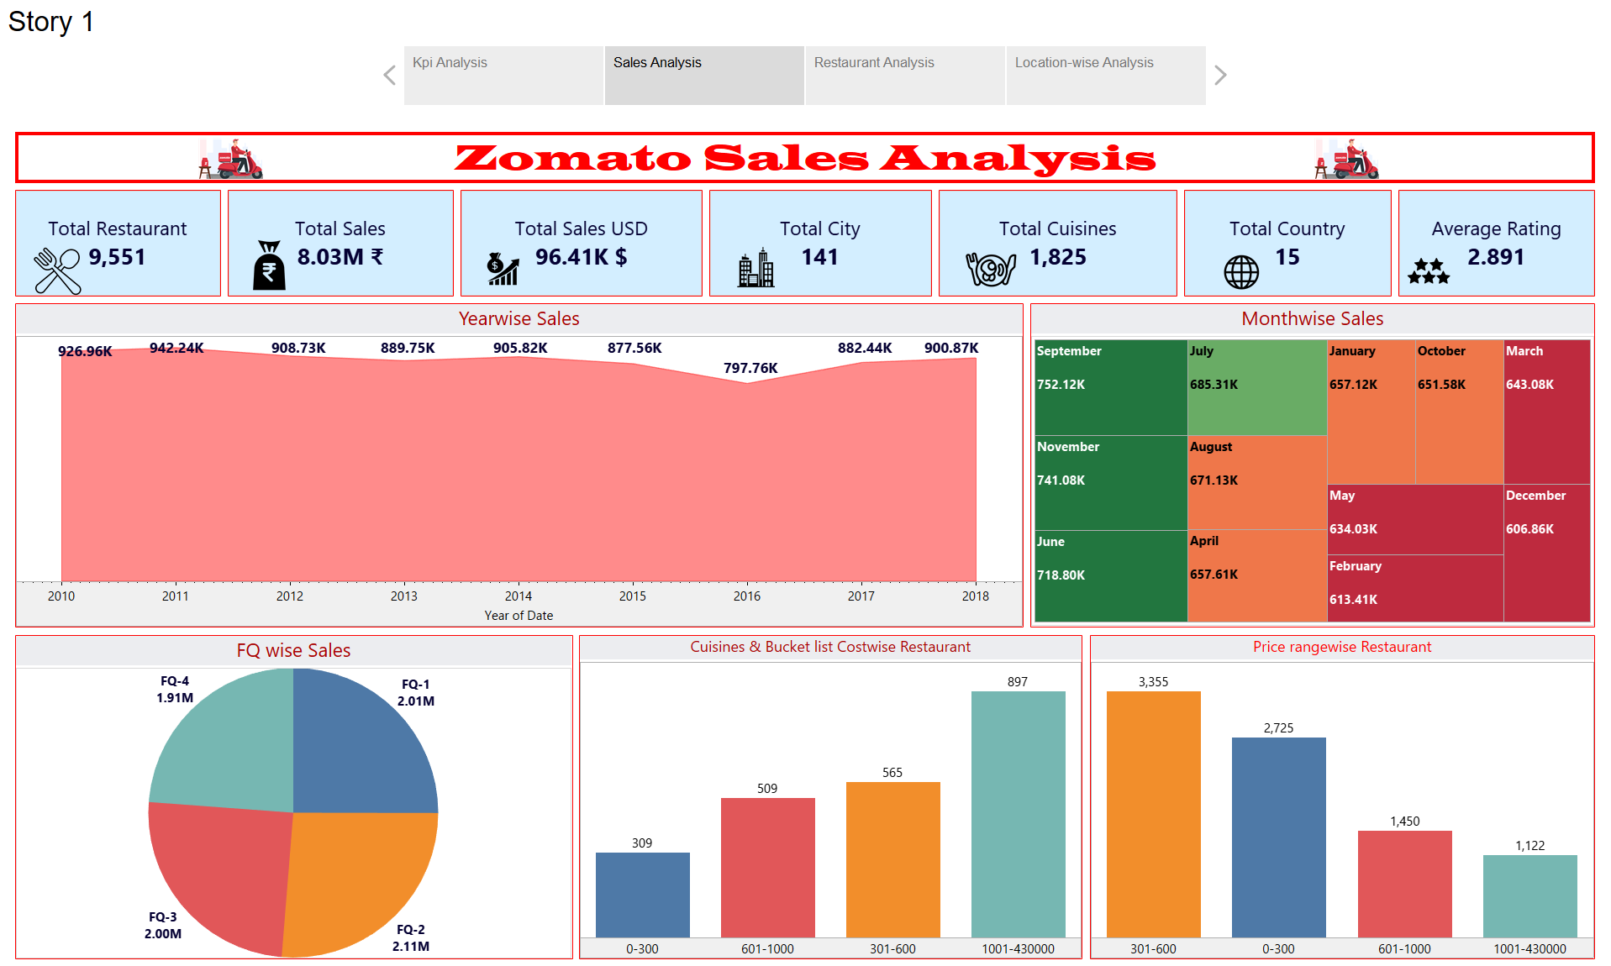

Slide 13
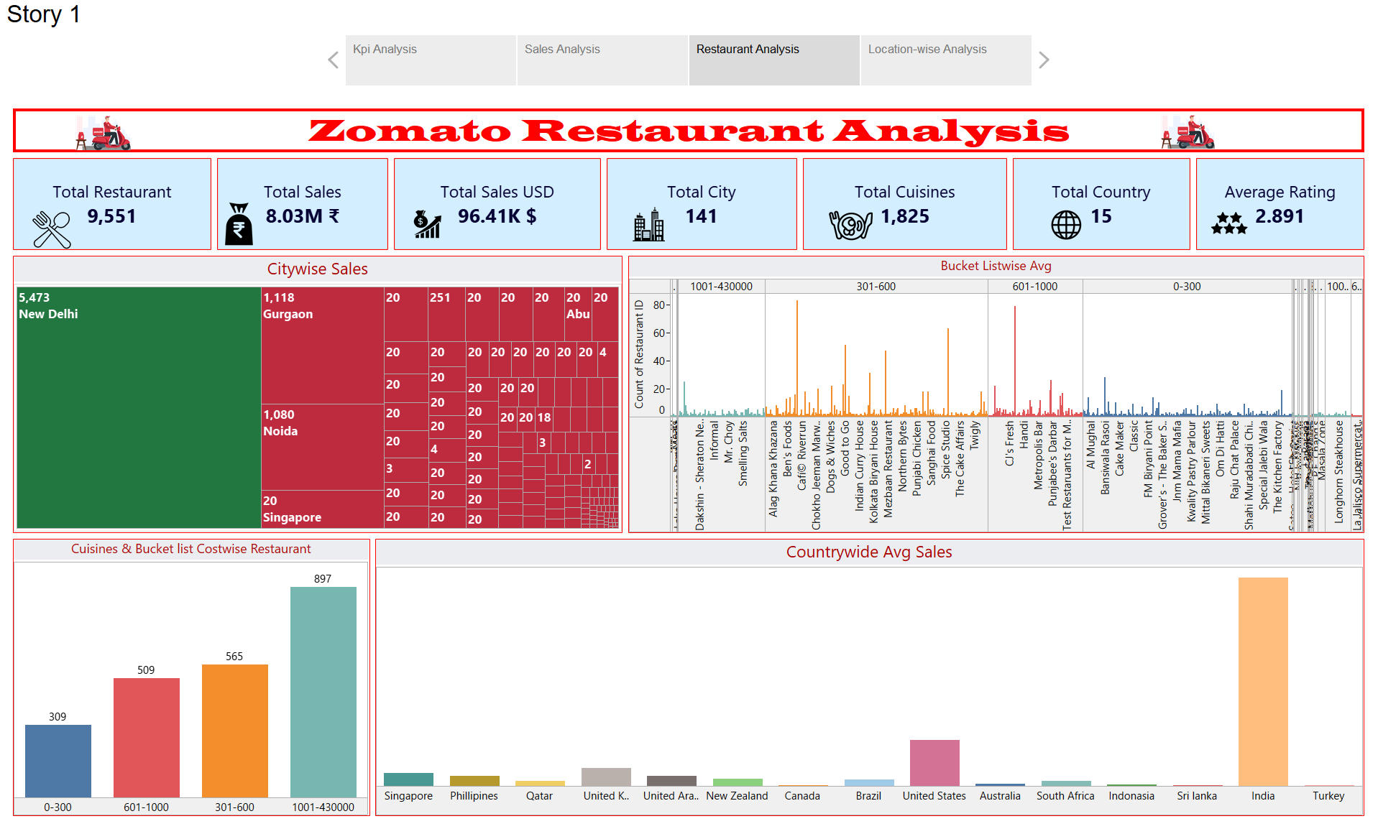

Slide 14
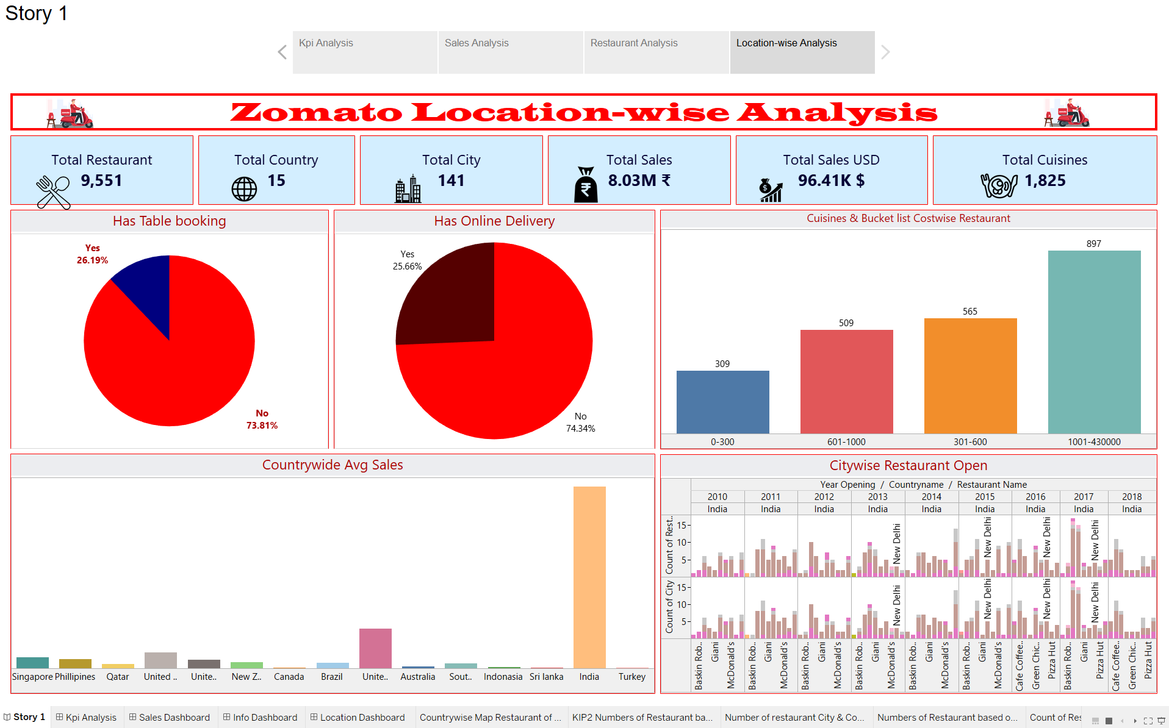

Slide 15
Thank You!

